Slide 1
Home Usability Program (HUP):
Effects of a consumer driven home modification intervention on community participation for people with mobility disabilities

Slide 2
Background
Efficacy Study 1: Promoting Interventions for Community Living
The contents of this presentation were developed under a grant from the National Institute on Disability, Independent Living, and Rehabilitation Research (NIDILRR grant number 90RT5043). NIDILRR is a Center within the Administration for Community Living (ACL), Department of Health and Human Services (HHS). The contents of this manuscript do not necessarily represent the policy of NIDILRR, ACL, HHS, and you should not assume endorsement by the Federal Government
A continuation of a previous pilot study with 30 consumers across 3 CILs from 2013-2017

Slide 3
Does participation in a consumer directed home usability intervention increase community participation for consumers with mobility disability?

Slide 4
Methods
Conducted at two Centers for Independent Living (in Missoula, MT and Kansas City, MO/KS) from 2017-2019
195 consumers participated across both centers
81 completed Home Usability Intervention
Remainder were in control, declined the intervention or withdrew from the study
Random Control Trial Design testing the efficacy of the Home Usability Program
Three measurement periods: pre-intervention, post-intervention (3 months for control), follow up (6 months)
Main measures of interest: Brief Community Engagement Questionnaire
Participation in trips (non-discretionary trips into community), social/recreational activities (discretionary community activities) and work/volunteering activities over the past 7 days.

Slide 5
Consumer Demographics
70% White, 21% Black
70% making less than 20,000/year
80% unemployed
63% identified as female
Average age=54 years old
Notes:
Bar chart showing: Co-occuring disability (ACS-6 set)
Hearing-10%
Vision-14%
Cognitive-43%
Self-Care-48%
Independent Living- 57%

Slide 6
Consumer Housing Characteristics
Housing tenure
67% renters
27% owners
6% other
Notes:
Housing type:
41% single family houses
41% apartments with 4+units
9% town houses and condos
8% other (manufactured housing mostly)
Housing age:
15% homes built before 1950
35% built between 1950-1990
27% built since 1991

Slide 7
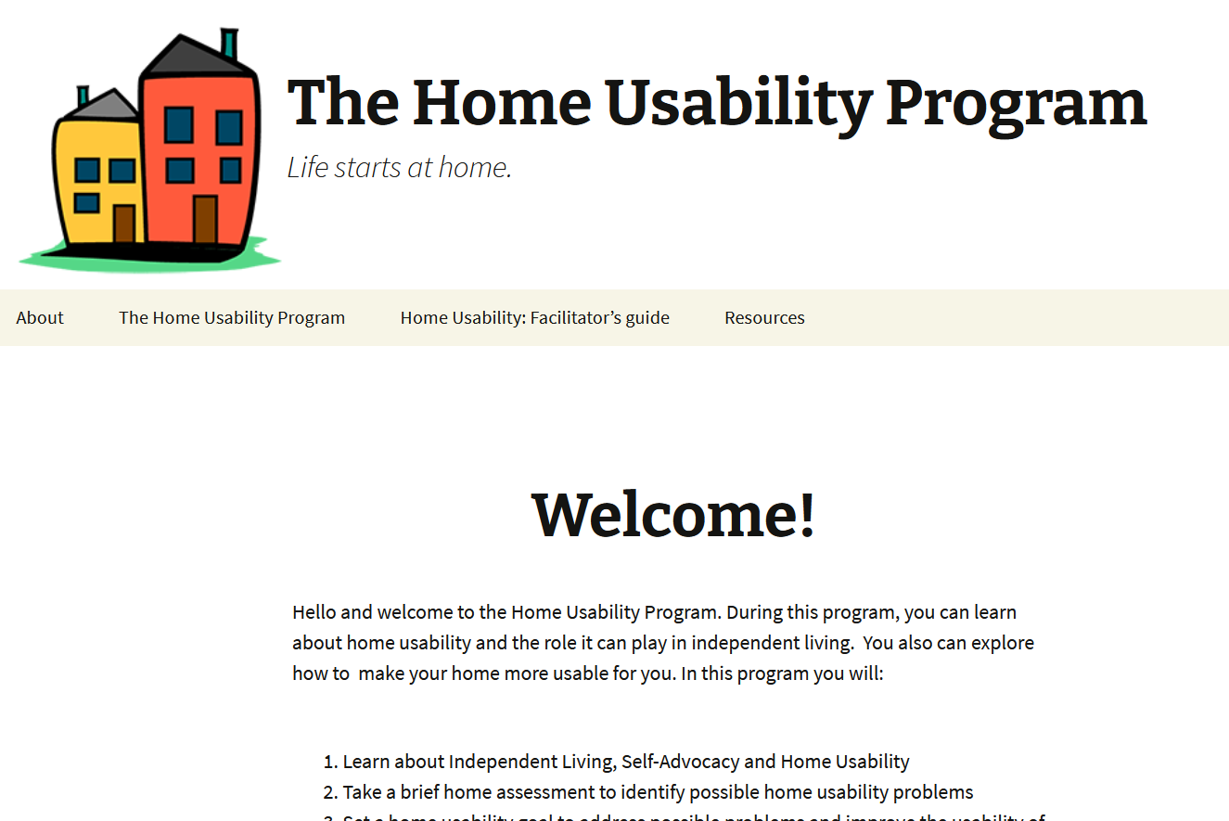
Intervention Procedures/Overview
Intervention content developed with a team of 5 CIL specialists from 5 different centers as part of pervious funding
Consumers work closely with CIL staff to work through intervention online or with printed manuals
www.useablehome.com
Consumers complete a home usability plan throughout the process
Home usability quiz
Home usability self assessment-AARP Home Fit Guide
Resources (social and financial)
Included a home visit by CIL staff when feasible

Slide 8
Project Classification
Classification | Examples
Bathing and grooming | Grab bars, shower chairs, non-slip mats
Cleaning | Robot vacuums, long handled dusters, storage
Mobility | Mobility devices such as walkers and canes
General safety | Fire extinguishers, medical alert device
Entrancing | Hand railings, video doorbells, threshold ramps
Cooking | Adaptive cooking equipment
Sleeping | New mattress
Moved | Moved to a more accessible space
Dressing | Assistive equipment
Furniture | Couch, desk
Assistive equipment | Reacher tool
Notes:
Bathing and grooming: Grab bars, shower chairs, non-slip mats, n=21, 25.9%
Cleaning: Robot vacuums, long handled dusters, storage n=15, 18.5%
Mobility: Mobility devices such as walkers and canes n=15, 18.5%
General safety: Fire extinguishers, medical alert device n=13, 16.0%
Entrancing: Hand railings, video doorbells, threshold ramps n=10, 12.3%
Cooking: Adaptive cooking equipment n=6, 7.4%
Sleeping: New mattress n=5, 6.2%
Moved: Moved to a more accessible space n=3, 3.7%
Dressing: Assistive equipment n=3, 3.7%
Furniture: Couch, desk n=2, 2.5%
Assistive equipment: Reacher tool n=2, 2.5%

Slide 9
Analysis and Results
Analysis
Results
Linear regression analysis to compare within person change in outcome scores of participants in the treatment group to within person change among participants in the control group
Controlled for:
self reported health status
month (season)
Consumer directed home usability changes positively impacted participation in social and recreational activities
Not trips or employment
Intervention participants reported a 39.5% (p < .05) increase in social and recreational activities immediately following the intervention relative to the control group after controlling for health status and month
Returned to baseline six months post the intervention
Bathroom, safety and sleeping changes seem to have the greatest impact
Sleeping (112%, p>.05)
Safety (80%, p>.05)
Bathing (72%, p >.01)

Slide 10
Discussion
Policy Implications
Impacts of Pandemic
Simple, consumer led home usability programs matter for community participation
Simple design
CIL staff led
No need for complicated procedures around PT/OT assessments
Consumer choice
Home usability is individual and dynamic
Trust the consumer, check assumptions at the door
Changes to intervention protocol/implementation
No home visits or in person contact
Zoom/over the phone assessments
Impacts on community participation for consumers
Both increased isolation AND increased remote connection via technology (socialization, employment opportunity, CIL support and connection)
Decreased opportunities in the community
Home usability is more important than ever
Loss of personal care
Staying active in the home (zoom fitness)

