Slide 1
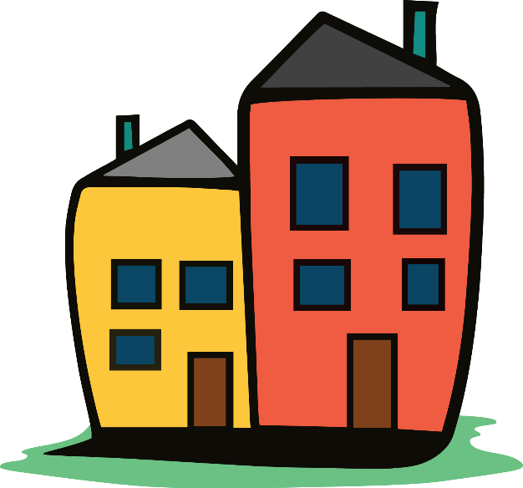
A Usable Home
A qualitative investigation of the relationship between home usability and community participation for people with disabilities

Slide 2
Acknowledgements
The contents of this presentation were developed under a grant from the National Institute on Disability, Independent Living, and Rehabilitation Research (NIDILRR grant number 90RT5043). NIDILRR is a Center within the Administration for Community Living (ACL), Department of Health and Human Services (HHS). The contents of this manuscript do not necessarily represent the policy of NIDILRR, ACL, HHS, and you should not assume endorsement by the Federal Government
Co-authors:
Dr. Lyndsie Koon
Dr. Jay Schulz
Dr. Dot Nary

Slide 3
Defining Home Usability
Usability vs. Accessibility
Not about required or universal standards or codes, about individualized needs and accommodations
Study Context
Promoting Interventions for Community Living (PICL) project
Social model and ICF framework for understanding participation for people with disabilities
“By thinking about the home environment more dynamically, home usability recognizes that there is not a clear line delineating the home from the community. In fact, the home is an integral part of the community in which a person lives, it is a space to rest and recuperate, a site where people prepare themselves to “go out into” community but also a space where they bring community in.”
We asked: How does home usability influence experience and participation within the home and out in the community?

Slide 4
Methods and Analysis
Qualitative analysis of 12 semi structured interviews
Purposively sampled consumers to capture a range of housing experiences
Limited the demographic diversity of our sample
Consumers were mostly white, mostly women, ages 21-65, had a range of education levels, mostly unemployed with lower levels of income (no household made more than $40,000)
Most interviews conducted in home with the consumer who participated in the Home usability program (PICL efficacy study 1) in both MT and KS/MO.
Interviews were uploaded, transcribed and analyzed in MaxQDA
Iterative analysis and coding to ensure concordance between researchers

Slide 5
Results revealed the personal, social, and environment factors that influence home usability and in turn one’s ability to participate in the community
Personal
Social
Environmental
Community Participation
Home Usability

Slide 6
Personal Factors
Personal factors relate to an individual’s health (e.g. ) and function (e.g. ). The subthemes associated with personal factors are physical health, mental health, and perceived safety.

Slide 7
More testimonials
Physical health
“I realized I wasn't able to get around in my bathroom. I still need handicapped faucets because I can't turn the bathtub off, if that makes sense. Its got one of those knob ones that's kind of like a dial like thing, but it's hard for me to turn because I lost 225 pounds four years ago when I had surgery to lose weight. I lost all my strength too.” – Connie, 49
Mental health
“I had to take prescribed medication just to get through a day in that place.”- Tina, 57
Safety
"Yeah, and it's[steps at home entrance]just been a pain ever since. Even trying to get into it or use it, for me is because there's really a wide step over and it's just that slippery area where I could fall down and bust my butt or head.“ – Steve, 50
Notes:
Physical health
“I realized I wasn't able to get around in my bathroom. I still need handicapped faucets because I can't turn the bathtub off, if that makes sense. Its got one of those knob ones that's kind of like a dial like thing, but it's hard for me to turn because I lost 225 pounds four years ago when I had surgery to lose weight. I lost all my strength too.”
Mental health
“I had to take prescribed medication just to get through a day in that place.”
Safety
"Yeah, and it's[steps at home entrance]just been a pain ever since. Even trying to get into it or use it, for me is because there's really a wide step over and it's just that slippery area where I could fall down and bust my butt or head."

Slide 8
Social Factors
Social factors are comprised of interpersonal relationships (e.g., family, friends, or neighbors), services and supports (e.g., access to and receipt of personal and social assistance), as well broader systems (e.g., social security) and systemic issues (e.g., poverty, ableism).

Slide 9
More testimonials
Interpersonal
"Yeah. He [spouse]helps me get dressed. I can't bend over and do my socks. And sometimes, we've gotta remember and I have to remember that he's disabled, too. He was in a motorcycle accident so we kinda struggle.“ –Cora, 57
Services and supports
"The only thing that keeps me from doing what I can do is that I don't have a way to get there or I don't have a ride. You give me a ride. I'm there." –Sheri, 60
Systems
"I'm not risking housing for anybody...I mean I could do it, it’s not worth the energy, but its ok.I’m not going to fight with her about it. I only had to wait 5 months to get housing, which is unheard of...so, you know I'm just like fine, I make concessions all the time.“ – Jocelyn, 50
Notes:
Interpersonal
"Yeah. He [spouse]helps me get dressed. I can't bend over and do my socks. And sometimes, we've gotta remember and I have to rememberthat he's disabled, too. He was in a motorcycle accident so we kinda struggle."
Services and supports
"Laundry, groceries. She[aide]does. She drives most of the time, I can't really. If I go somewhere where and I don't have my walker, I do it withoutshoes[for balance]. In fact,I went without shoes a lot of winter because I didn't have an aide and I was out in the snow."
Systems
"I'm not risking housing for anybody...I mean I could do it, it’s not worth the energy, but its ok.I’m not going to fight with her about it. I only had to wait 5 months to get housing, which is unheard of...so, you know I'm just like fine, I make concessions all the time."

Slide 10
Environmental factors
Environmental factors represent both the immediate home environment in terms of home design, layout, and quality, as well as the surrounding neighborhood and geographic location (e.g., in a rural area, or different neighborhoods/communities).

Slide 11
More testimonials
Design
"I've, during flares, have had a really hard time getting off of the toilet. I mean, it's really weird, the way my bathroom is, the door's right in front of you, and I had nothing to grab to get up. I'd leave it open and use the doorknob to pull myself up.“ –April, 21
Geography
“Nobody wants to help me. I wish to God I never would've bought a house in [town name]. This is my honest to God feeling because I don't feel like they're [service providers] here to help us.” –Theresa, 65
Notes:
Design
"I've, during flares, have had a really hard time getting off of the toilet. I mean, it's really weird, the way my bathroom is, the door's right in front of you, and I had nothing to grab to get up. I'd leave it open and use the doorknob to pull myself up."
Geography
“Nobody wants to help me. I wish to God I never would've bought a house in [town name]. This is my honest to God feeling because I don't feel like they're [service providers] here to help us.”

Slide 12
Conclusion and implications
“Home usability is an interaction between an individual and their environment, illustrating how the two interact with and inform each other to produce an individual’s lived experience in space.”
“Homes matter for participation as they are critical as sites of social engagement, entryways into the community, spaces of rest and rejuvenation from the community.”
“…results reveal a need to develop more holistic housing and home modification programs and policies that invite consumer choice and control in addressing home usability concerns while ensuring these policies and programs are obtainable by all.”

Slide 13
Thank you!
Lillie Greiman, Lillie.Greiman@umontana.edu

