Slide 1
Insights on an Automated Fall Detection Device Designed for Older Adult Wheelchair and Scooter Users: A Qualitative Study
Laura A. Rice, PhD, MPT, ATP; Alexander Fliflet, MS; Mikaela Frechette, MS; Rachel Brokenshire; Libak Abou, MPT, PT; Peter Presti, MS; Harshal Mahajan, PhD; Jacob Sosnoff, PhD; Wendy A. Rogers, PhD

Slide 2
Session Outline
Discuss problems associated with falls among individuals who use wheelchairs and scooters
Understand limitations of fall detection devices on the market
Become aware of preferences for an automated fall detection device expressed by individuals who use wheelchairs or scooters.

Slide 3
Fall Frequency
Individuals who use Wheelchairs or Scooters
~60% have experienced a fall over their lifetime
Multiple Sclerosis: 75% report at least 1 falls/6 months
Spinal Cord Injury: 69% report at least 1 fall/12 months
68% of fatal wheelchair accidents are from falls
Ambulatory older adults
30-40% fall at least once per year

Slide 4
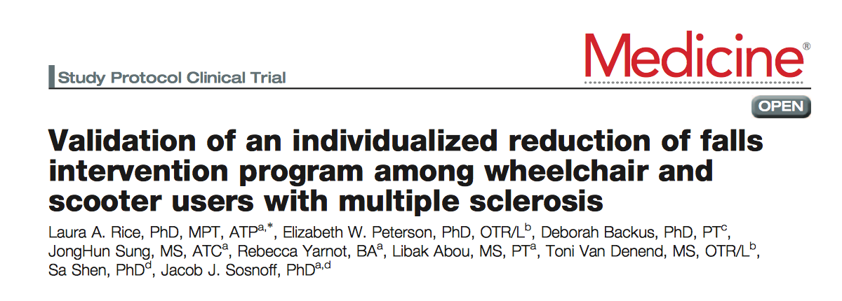
Fall Prevention
First line of defense
Limitations
Limited peer reviewed fall management programs
Total prevention is not possible

Slide 5
Significance
Comprehensive Fall Management
Post Fall Management
Fall Risk Management Interventions
Identification of Fall Risk

Slide 6
Aftermath of falls
Injury
Delayed Initial Recovery/Long lie period
Recovery (getting up)
Fear of falling/Limitations on Participation

Slide 7
Aftermath of falls
Injury
Delayed Initial Recovery/Long lie period
Recovery (getting up)
Fear of falling/Limitations on Participation

Slide 8
Lie Time
Period of time that a person is on the ground after a fall occurred
Long lie (>1 hour on the floor) is predictive of:
Future injurious falls
Decline in performance of ADLs
Increased hospital admissions
Admission to long term care facilities
Lie time among wheelchair users
n = 39 wheelchair users
Average lie time = 9 minutes,
Range: 1 – 45 minutes
>10 min = n = 10

Slide 9
Challenges with recovery
Needing assistance with recovery is associated with:
Poor quality of life
Serious injuries
Death
Assisted recovery:
77.5% of wheelchair users need assistance to recover (n = 40)
50% of ambulatory older adults
Manual wheelchair users who required assistance to recover had lower reports of community participation (n = 20)
Bloch, 2012; Rice, 2018 & 2019

Slide 10
Fear of falling
Fear of falling:
N = 68 wheelchair users
61% reported fear of falling
51% stopped doing activities due to fear of falling
Relationship found between fear of falling:
Quality of life (physical and psychological health)
Control over participation
Sung, 2019

Slide 11
Automated Fall Detection Devices
Limitations in automatic notification
Designed for ambulatory population
Falls from wheelchairs are distinct
Apple watch (Series 5)
Detected 14/300 falls from a wheelchair (4.7%)
Forward falls: 9/14 falls
Detection may be influenced by:
height
impact force
lower limb function
fall direction
Abou, 2021

Slide 12
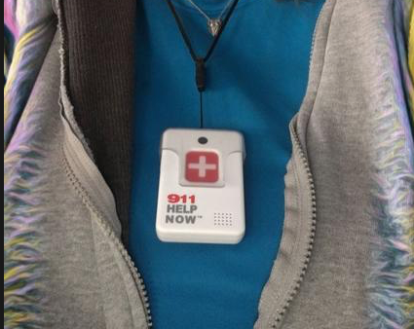
Limitations of current fall detection devices
Limited use of self-triggering devices
Don’t want friends/family notified
Obtrusive
Limitations on who is notified

Slide 13
Development Goals
Development of a product that can:
Reliably automatically summon assistance in the event of a fall
End-user is able to select who is called
Non-device specific
Preserves dignity

Slide 14
Study Progress
Phase I: Measure fall acceleration patterns to detection fall event from a wheelchair
Phase II:
Develop a prototype of a customizable fall detection system to identify a fall event and notify caregivers/emergency professional
Get feedback from participants on preferences of device

Slide 15
Participant Preferences
Semi-structured interviews performed with individuals who use a wheelchair and scooter
Quantitative assessments on technology acceptance
Participants
n = 15
Variety of health conditions
Age: 68 ± 5 year
Use of wheelchair or scooter for 23 ± 17 years
Fallen 3 ± 3 times in the past 12 months (range 0-12)
Rice, 2021

Slide 16
Perceived Usefulness
Agreed or strongly agreed with the following statements:
Increase ability to recover from a fall
Decrease lie time after a fall
Decrease fear of falling
Useful inside or outside place of residence

Slide 17
Current use of a fall detection device
Helped to recover when alone
“When my significant other was in the hospital…So yes, I wore the button” (Participant 13)
Challenges expressed in finding something that fit needs
“Well, I've not found something that would fit my needs..”(Participant 11)

Slide 18
Preferred Features
Look of the device: conservative, sleek, and small design
“If it looks out of normal and people would talk about it or what it was, I think it should look high tech.” (Participant 10)
Form: Watch with wireless charging
Concerns noted about don/doffing of device
“I prefer stretch bands where they slip over your wrist. I do not have very good dexterity in my hands” (Participant 4)

Slide 19
Preferred Features
Who to notify in the event of an emergency:
Emergency services
Family members
Care partners
Friends
Would like to easily change who is notified
“My significant other and my caregiver... I would like it to be able to be changed, like two different caregivers so that you could adjust it.” (Participant 1)

Slide 20
Preferred Features
How to send a notification that an emergency has occurred
Short message service (SMS) or call
"A phone call. That would be a certain, as people don't always really read their texts." (Participant 8)
Would like to be notified that help is on the way
“Some kind of audible alert that you can hear, might give you a message that you know it is working properly” (Participant 4)
Notes:
However, some participants indicated that a phone call would provide assurance that help was on the way. Similar to selecting a primary contact, the decision to send a SMS or a call would be set in the fall detection device preferences at set-up but could be modified as circumstances change.

Slide 21
Preferred Features
Would like the ability to disable a notified (false alarm)
“A false alert definitely can happen, so I definitely want it…but if you hit your head, you don’t know what state you’re going to be in so, not too long. Maybe five minutes [to cancel it].” (Participant 3)

Slide 22
Discussion
Indicated the need for an automated fall detection device to facilitate recovery from a fall.
Challenges with previous fall detection devices noted
Specific design requirements are needed to facilitate ongoing use.

Slide 23
Next Steps
Build the device
Community testing (Dec. 2021)

Slide 24
Thank you!!
ricela@Illinois.edu

