Slide 1
The Presents: A State-of-the-Science Virtual Conference
This virtual conference is funded through a grant from the National Institute on Disability, Independent Living, and Rehabilitation Research (NIDILRR grant number 90RT5043). NIDILRR is a Center within the Administration for Community Living (ACL), Department of Health and Human Services (HHS). The contents of the presentations do not necessarily represent the policy of NIDILRR, ACL, or HHS, and you should not assume endorsement by the Federal Government.

Slide 2
Accessibility Features
Automated captioning is available on today’s call.
Turn on captioning by clicking on the “CC Live Transcript” in the Zoom toolbar
You’ll see “show subtitle,” which turns on the captions
In that same location, you can adjust the size of the captions to meet your needs by selecting “subtitle settings”
We have sign language interpreters on the webinar: Jolene Benham and Hannah Randolph.
We are using gallery view in Zoom to see both the shared screen and interpreter.
If you only see the shared screen, go to the top of your Zoom window, and move your cursor on the green bar at the top that reads, “view options”
Click on that arrow and make sure that you are in “Side-by-Side Mode”

Slide 3
Q&A Facilitation
Kelsey Goddard will moderate questions at the end of the presentation.
We will answer questions in the order they come in, and we will try to get through as many questions possible.
To ask a question please use the Q&A button at the bottom of the screen.
If the Q&A box is not accessible to you, you can use the “raise hand” feature
If you are joining by telephone, press *9 to raise your hand.
When it’s time for questions, Kelsey will call on you and unmute your line so you can ask your question.
Do not use the chat feature to ask questions to presenters.

Slide 4
State-of-the-Science on Community Participation

Slide 5
Community Participation
Important role in overall well-being and quality of life
Lack of social connections associated with negative physical and mental health outcomes
Opportunity is an essential ingredient of community participation
Opportunity is shaped by structural, environmental, and sociodemographic factors
The intersection of personal and environmental factors shape opportunity
Community participation is the gold standard for research outcomes

Slide 6
The SOS Conference Agenda
Leaders in the field of community participation research
3 webinar series:
Setting the Stage for Understanding Community Participation
Factors Influencing Community Participation
Applying Lesson Leaned to Increase Community Participation
Diverse agenda representing multiple aspects of opportunity
Early intervention, AT, home usability, transportation, fall detection, online community building

Slide 7
Conference Speaker Selection
American Institutes for Research (AIR) Campbell Collaboration
Systematic Review – literature review between 2000 and 2016
Interventions in community settings that addressed two or more individual and/or environmental factors
4,734 articles screened for inclusion, 15 articles selected
Disability and Health Journal Online Supplement
Improving Community Living and Participation for People with Mobility Impairments

Slide 8
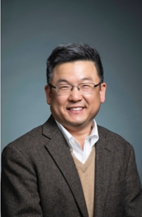
Dr. Gilbert Gimm
Associate Professor of Health Administration and Policy
George Mason University

Slide 9
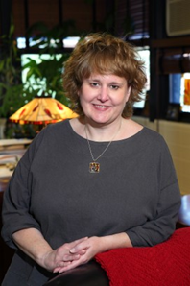
Dr. Joy Hammel
Community-based Participatory Action Researcher
Disabled person
Scholar

Slide 10
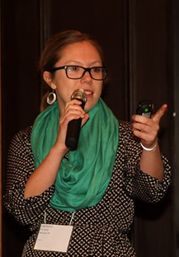
Lillie Greiman
RTC:Rural Project Director
RTC/PICL Researcher
University of Montana

Slide 11
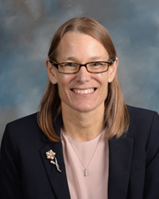
Dr. Jean Hall
Institute for Health and Disability Policy Studies
RTC/PICL PI
University of Kansas

